Slide 1
WHO IS ABOUT TO WITHDRAW
AN EARLY WARNING FOR DISTANCE LEARNING STUDENTS
AKSHAYA CHEVVA
PRACTICUM – 1
Open University Learning Analytics Dataset, 2013 to 2014. 22,476 students still enrolled at day 28, in the 16 of 22 course runs with marked work due by then.

Slide 2
Start calling the students who have handed nothing in by day 28, and measure whether it works
That list is 13 percent of the class and a quarter of everyone who will leave this term is on it.
It is two columns of the gradebook. Ready the day the first assignment closes, no model needed to build it.
Measuring is half the ask. Nothing in this data says whether a phone call helps. Only you can find that out.
Open University Learning Analytics Dataset, 2013 to 2014. 22,476 students still enrolled at day 28, in the 16 of 22 course runs with marked work due by then.

Slide 3
We already agree that the time to catch a leaver is early. We watch logins to do it
Nobody argues about the goal. 18 percent of the students still enrolled at day 28 go on to withdraw. In one term that is 1,698 people.
Day 28 is the first point there is anything to see. 16 of 22 course runs have had marked work due by then.
And the tool everyone already has is the activity dashboard. Logins, clicks, last seen. That is the part I want to argue with.
Open University Learning Analytics Dataset, 2013 to 2014. 22,476 students still enrolled at day 28, in the 16 of 22 course runs with marked work due by then.

Slide 4
Logging in is the wrong warning sign, handing in work is the right one
Same number of calls, far fewer of the right people. A list of the quietest students by activity, exactly the same size, holds 17 percent of the dropouts. The missing-work list holds 24.
The busiest students can be the ones leaving. A student who logs in plenty and has handed nothing in is the single highest risk group in the data, 40 percent.
That student is green on the dashboard. Lots of clicks, nothing handed in, and about to go.
Open University Learning Analytics Dataset, 2013 to 2014. 22,476 students still enrolled at day 28, in the 16 of 22 course runs with marked work due by then.

Slide 5
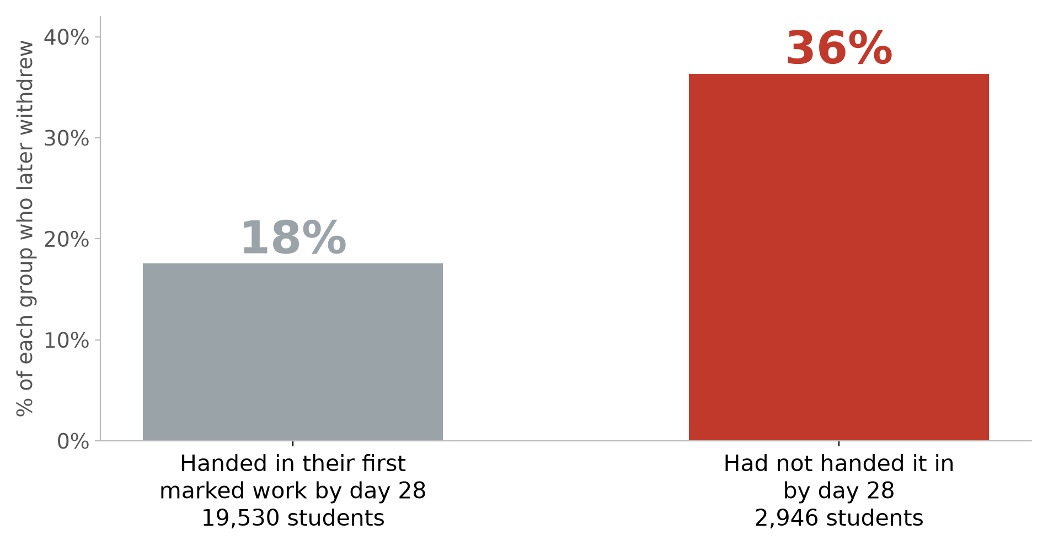
Students with nothing handed in by day 28 dropped out at twice the rate
Open University Learning Analytics Dataset. The 16 of 22 course runs with marked work due by day 28. 'Handed in' leaves out 471 students whose only mark was carried over from an earlier attempt. Shows who is at risk, not whether contacting them helps.

Slide 6
It is not one strange course, and it is not a handful of students
The gap holds in all five courses that set marked work before day 28. Lowest 12 against 26 percent, highest 27 against 48.
The list is 2,946 students across four terms. About 736 calls a term across the whole university, and a median of 211 students in any one course.
That is a size a teaching team can actually work through. It is not a research programme, it is a morning.
Open University Learning Analytics Dataset, 2013 to 2014. 22,476 students still enrolled at day 28, in the 16 of 22 course runs with marked work due by then.

Slide 7
There is time to act: they leave around day 86, not day 29
Only 12 percent of the flagged students who leave go in the first week after the cutoff.
The median one leaves on day 86, which is 58 days after the call would have been made, in a course that runs about 240.
So the window is real. If they were all gone by day 35 I would be telling you to do something else.
Open University Learning Analytics Dataset, 2013 to 2014. 22,476 students still enrolled at day 28, in the 16 of 22 course runs with marked work due by then.

Slide 8
I chose the points system over the black box: same catch rate, and every name comes with its reasons
The fancier model does not win. Against a random forest and gradient boosting, tested forward on two terms it had never seen, they tie.
So I take the one I can explain. Nothing handed in, low score, quiet on the site. Three reasons, in order, next to the name.
And it earns its place over the plain flag. Same 810 calls on the test term, the points system finds 75 more of the students who leave, and 46 percent of its calls are right against 37.
Open University Learning Analytics Dataset. 27,460 students still enrolled at day 28, trained on three older terms and tested on the newest one, with repeat students kept out of training.

Slide 9
What this cannot tell you
Nobody has tested whether calling helps. I can show you who is at risk. There is no record in this data of anyone being contacted, so the effect of a call is unmeasured, by me and by everyone else.
Two of seven courses set no work before day 28. For those students the trigger does not exist, and I would not pretend otherwise.
It is 2013 to 2014, one UK university. And the list leans on the most deprived students slightly harder than their risk alone justifies, 1.7 times the flag rate against 1.4 times the risk.
Open University Learning Analytics Dataset, 2013 to 2014. 22,476 students still enrolled at day 28, in the 16 of 22 course runs with marked work due by then.

Slide 10
Run it for one term, write down what happens, and we will know by summer
Pick the courses that set early work. Call the list. Record who was called, who was reached, and what was said.
Keep a group you do not call. Without that, next year I am standing here saying the same thing I am saying now.
One term is enough to see it. 736 calls, one cohort, and the question stops being a guess.
Open University Learning Analytics Dataset, 2013 to 2014. 22,476 students still enrolled at day 28, in the 16 of 22 course runs with marked work due by then.

Slide 11
Call the students who have handed nothing in by day 28, and measure whether it works
Who: the 13 percent with nothing handed in. A quarter of the term's leavers are there.
Why not the dashboard: the quiet list finds 17 percent of them, this one finds 24.
What I still owe you: proof that the call itself does anything. That is next term's job, not this one's.
Open University Learning Analytics Dataset, 2013 to 2014. 22,476 students still enrolled at day 28, in the 16 of 22 course runs with marked work due by then.

Slide 12
Thank you!
ANY QUESTIONS..

